Slide 1


GitHub Collaboration, Remotes & Profile Markdown
An in-depth guide for beginners: Master remote repositories, cloning, forking, branching, pull requests, and building an impressive GitHub developer profile README.

Slide 2

Remote Repositories & Collaboration
Connecting your local Git environment to the cloud and collaborating safely with teams.

Slide 3


Forking vs. Cloning Explained
Forking (Server-Side)
Cloning (Server to Local)
Creates a personal copy of someone else's GitHub repository under your own GitHub account.
Downloads a copy of a remote GitHub repository to your local computer using the terminal.
Happens entirely on GitHub.com
Command: git clone
Gives you full write access to your copy
Configures origin remote automatically
Used for open-source contributions
Allows offline work on your machine

Slide 4

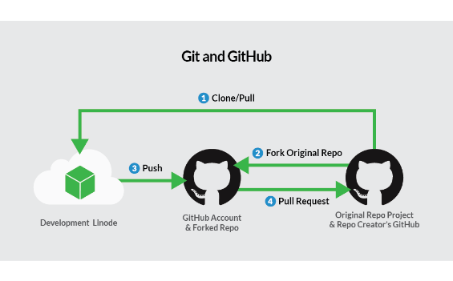
The Complete GitHub Workflow
Fork & Clone: Fork the target repository and clone it to your local machine.
Branch Out: Create a feature branch with git checkout -b feature-name.
Commit & Push: Stage edits, commit locally, and run git push origin feature-name.
Open Pull Request: Submit a PR on GitHub for code review and approval.

Slide 5

Synchronizing Remote Changes
Understanding how code moves between your local workstation and the cloud repository.

Slide 6
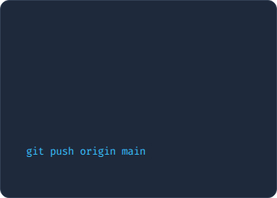
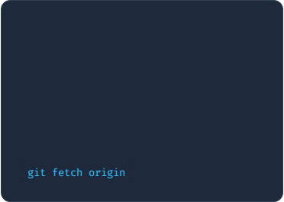
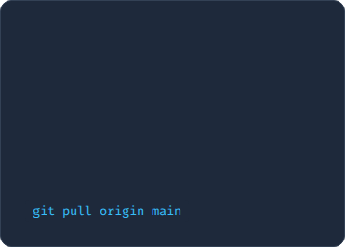



Push, Fetch, and Pull
1. git push
2. git fetch
3. git pull
Uploads local commits to the remote repository on GitHub.
Downloads remote updates to local metadata without altering your working files.
Fetches remote changes and immediately merges them into your active branch.

Slide 7

Remote Commands Reference
Command | Action / Purpose | Beginner Tip
git clone | Copies a remote repository to local folder | Only run this once per project!
git remote -v | Lists configured remote server URLs | Check where your code is pushing
git checkout -b | Creates and switches to a new branch | Always branch for new features
git push -u origin | Uploads branch & sets tracking upstream | Sets default target for future pushes
git pull | Fetches latest changes and merges them | Run before starting new work

Slide 8

Markdown & Profile Creation
Crafting readable documentation and crafting an impressive GitHub Developer Profile README.

Slide 9


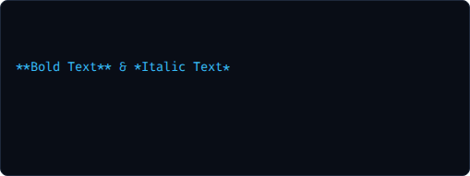

Markdown Cheat Sheet for Beginners
Markdown Syntax
Rendered Preview
# Heading 1
Heading 1
## Heading 2
Heading 2
Bold Text & Italic Text
- Bullet point 1
•
Bullet point 1
- Bullet point 2
•
Bullet point 2
[Portfolio](https://myurl.com)
`inline code`
Portfolio Link

Slide 10
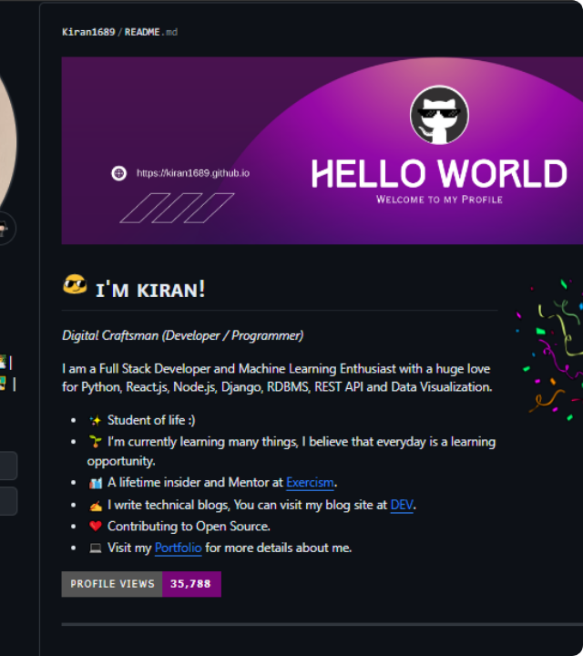
Your GitHub Profile README
GitHub allows you to create a special repository named after your username (e.g., username/username).
The README.md in this repository is automatically pinned to your public GitHub profile page, acting as your developer portfolio card!
Highlight active projects & skills
Add dynamic GitHub stats & streak badges
Link your Twitter, LinkedIn, and blog

Slide 11


Image Sources
https://miro.medium.com/1*FlAX79JdB2sk56_LUfLXIg.png
Source: medium.com
https://repository-images.githubusercontent.com/678715471/b80f7763-9f3e-4452-afb2-1457b31f77fc
Source: github.com

